Slide 1

ELL Instructional Academy
Karina E. Chapa, M.Ed.
Language Proficiency, Biliteracy and Cultural Diversity Director
kchapa@esc1.net
Twitter @esc1bilingual @bilingualpride

Slide 2

Professional Learning Essential Agreements
Be respectful of others
Be an active participant
Take care of your needs
Use electronic devices as learning tools
©2018 Region One Education Service Center

Slide 3
Sheltered instruction
Strategies

Slide 4
Session Objectives
Content Objective
Language Objective
Today I will explore sheltered instruction techniques and strategies to make content comprehensible for my ELLs.
Today I will share different ideas on how to implement sheltered instruction strategies in the classroom.

Slide 5
Three-Step Interview
Stand up when you can complete one of these sentences:
  Teaching ELLs is so difficult because…
  One challenge I face when teaching ELLs is…
  One challenge I face when instructing ELLs is… What I have done to overcome this challenge is…
Beginner
Intermediate
Advanced

Slide 6
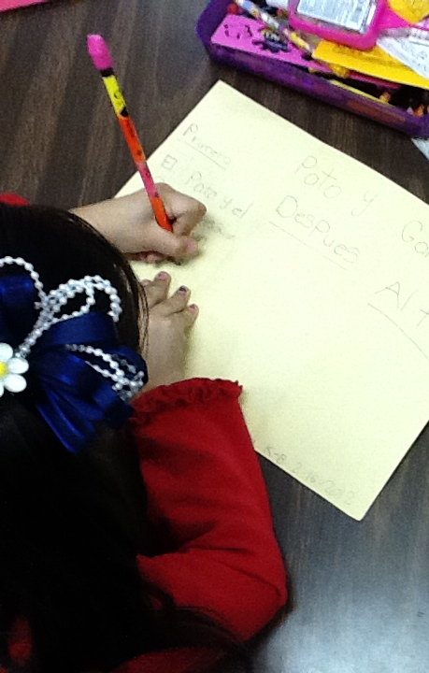
What are the two goals of Sheltered Instruction?
Make Content Comprehensible
Develop Academic Language

Slide 7
Content and language objectives

Slide 8

Anticipation Guide
kahoot.it
create.kahoot.it
Let’s Kahoot!

Slide 9
Round Table
Divide a piece of paper in two sections
Create a T chart
Write everything you know about content and language objectives
15 seconds!
Pass your paper to your right!
Repeat!
Content Objectives
Language Objectives
Let’s Write!

Slide 10
The What and the How
Content Objectives come from the TEKS
What am I going to learn?
Language Objectives come from the ELPS
How will I demonstrate my learning through listening, speaking, reading and/or writing?
Content and Language Objectives

Slide 11
Content Objective - Sample
Science TEKS: Differentiate between structure and function in plant and animal cell organelles including cell membrane, cell wall, nucleus, cytoplasm, mitochondria, chloroplast and vacuole.
Student Friendly format: Today I will compare and contrast the cell structures and functions of plants and animals.

Slide 12
Science TEKS: Differentiate between structure and function in plant and animal cell organelles including cell membrane, cell wall, nucleus, cytoplasm, mitochondria, chloroplast and vacuole.
CONTENT OBJECTIVE
Today I will compare and contrast the cell structures and functions of plants and animals.

Slide 13
Writing Content Objectives
Pair-up
Analyze a Student Expectation (TEKS) from any content area
Write it in a student-friendly format
You have 2 minutes
Write it on the top of a chart paper
Today I will…

Slide 14
Language Objective - Sample
Content Objective:
Today I will compare and contrast the cell structures and functions of plants and animals.
Language Objective:
Today I will write an essay comparing and contrasting plant and animal cells utilizing transitional phrases.

Slide 15
Writing Language Objectives
Pair-up
Look back at the content objective you wrote
Write a language objective in a student-friendly format
You have 2 minutes
Write it on the chart paper below the content objective
Today I will…

Slide 16
Science TEKS: Differentiate between structure and function in plant and animal cell organelles including cell membrane, cell wall, nucleus, cytoplasm, mitochondria, chloroplast and vacuole.
CONTENT OBJECTIVE
Today I will compare and contrast the cell structures and functions of plants and animals.
LANGUAGE OBJECTIVE
Today I will write an essay comparing and contrasting plant and animal cells utilizing transitional phrases.

Slide 17
Key Points to Remember
Make objectives student friendly and appropriate for grade level
Objectives are for students, not for the adults in the classroom
Post eye level
Review with students before, during and after each lesson

Slide 18
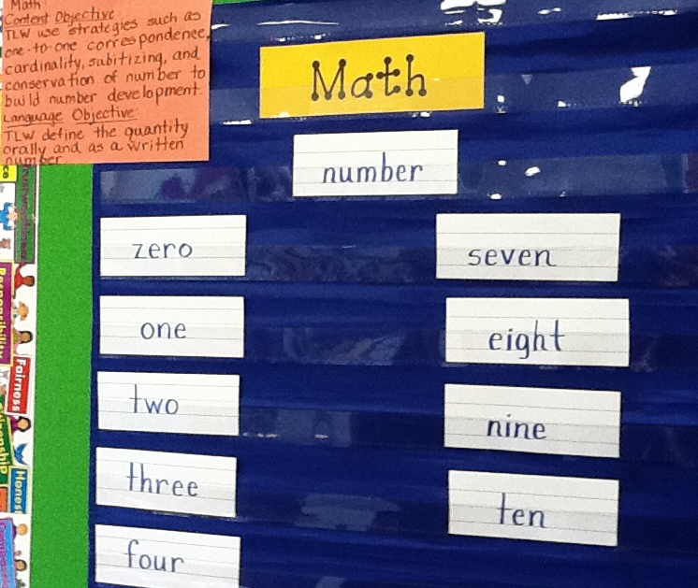
Provide Feedback
Content and Language Objectives

Slide 19
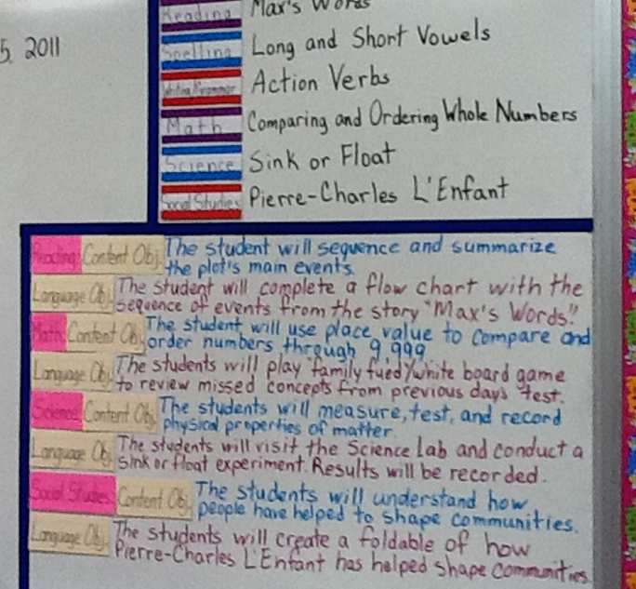
Provide Feedback
Content and Language Objectives

Slide 20
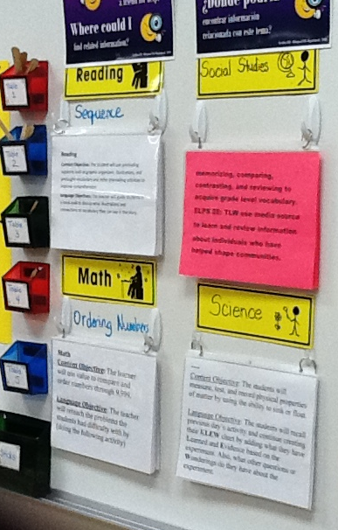
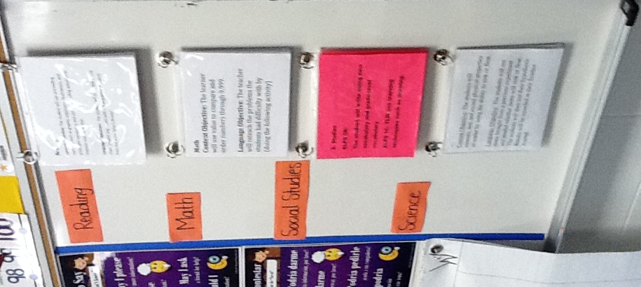
Provide Feedback

Slide 21
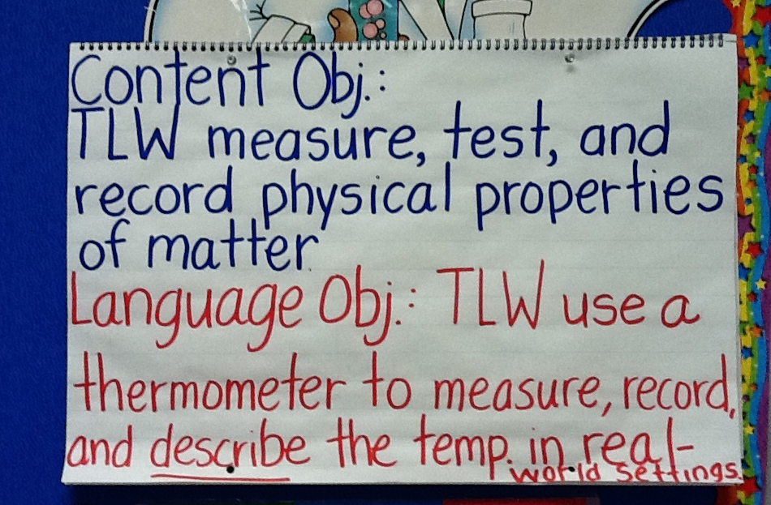
Provide Feedback

Slide 22
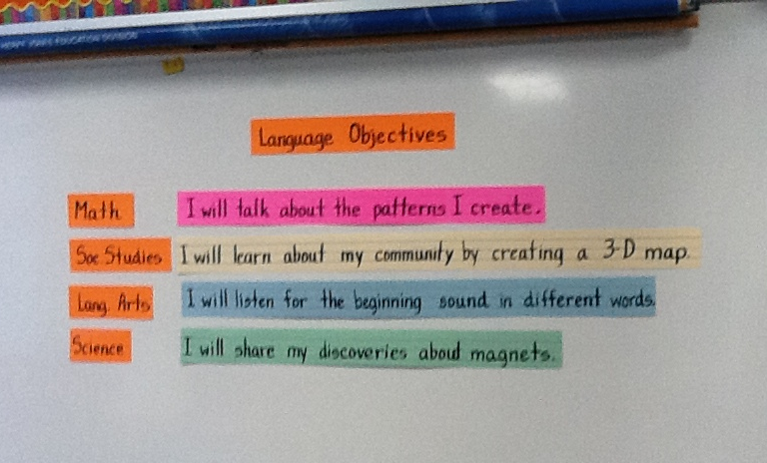
Provide Feedback

Slide 23
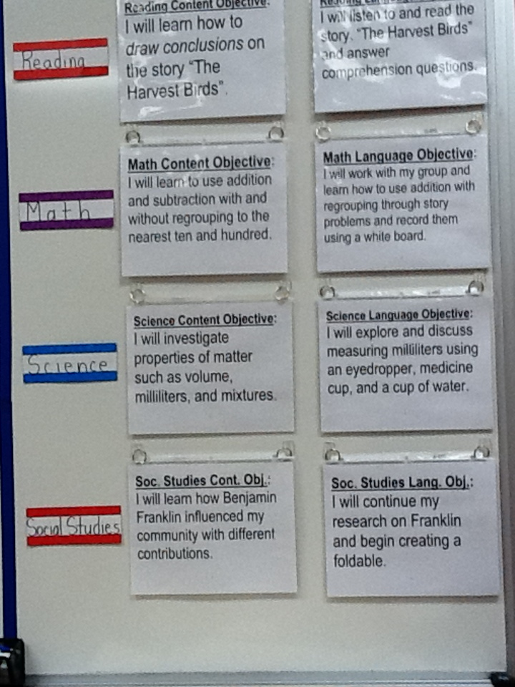
Provide Feedback
Content and Language Objectives

Slide 24
Speaking in complete sentences

Slide 25
1-2-4-ALL
Why is it important to encourage English Learners to speak in complete sentences?
Write your individual answer on a piece of paper.
Share with a partner and add any new ideas to your paper.
Now share with another pair your answers and keep adding new ideas to your own papers.
As a whole table come up with a final complete answer.

Slide 26
Use of Complete Sentences
Does this mean that students need to answer in complete sentences all the time?
TIP:
Provide students with sentence frames and sentence starters if they are struggling to produce complete thoughts in English.

Slide 27
Use of Complete Sentences
  1. When reviewing a handout or worksheet
    Non-Example
    Teacher: How much is 5 X 4?
    Student: 20!
    Example
    Teacher: What is the product of 5 X 4?
    Student: The product of 5 and 4 is 20

Slide 28
Use of Complete Sentences
  2. When students are given sentence starters
    Non-Example
    Teacher: Who is your favorite character and why?
    Student: Esperanza!
    Example
    Teacher: Who is your favorite character and why? Please complete the following sentence: “My favorite character is… because…”
    Student: My favorite character is Esperanza, because she was very brave.

Slide 29
Your Turn! Gallery Walk!
Using the Content and Language Objectives that you developed, write 3 questions and 3 sentence stems that your students might be able to answer throughout the lesson.
Write them on post-its and place them on your chart paper.

Slide 30
RANDOMIZATION TECHNIQUES

Slide 31
Randomization Techniques
Write-Read-Read-Trade
Stand up when you complete in writing one of these sentences:
  I select who I call on by…
  In my classroom, I include randomization because…
  The most beneficial randomization technique I have used is… because…
  Write the same answer in two different post-its.
  Inside-Outside Circle!

Slide 32
Randomization Techniques
Is it possible to randomize and differentiate instruction at the same time?
Randomize and rotate who is called on,
so students of all language levels can participate!

Slide 33
Randomization Techniques
Lucky sticks
Beach ball
Index cards
with student names
Class list/roster
Color/numbers
Birthdays
Physical characteristics: longest hair, eye color…
Jenga
Pick up sticks
Career cards
Apps
Popcorn

Slide 34
Total response signals

Slide 35
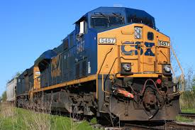
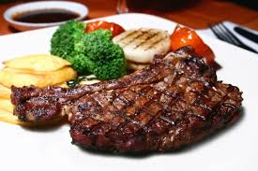
Why is it important to check for understanding along the way?

Slide 36
Written Responses
Hold up paper
White boards
Ready Responses
Hands up when ready
Personal Chalkboards
Answers on cards
Thinker’s chin
Stand up when ready
Put your pen on your paper when ready
All eyes on teacher
Making Choices
Open hand/closed hand
Ranking
Rank with your fingers
Thumbs/Pens up/down
Number wheels
Green card/red card
Move to the corner/spot
Rank with your arm
Line up according to response
Knocking/clapping/
cheering

Slide 37
Find the Fib!
Students may work in pairs or small groups.
Students have three post-its/index cards with the numbers “1, 2, 3” in each card.
Teacher writes 3 statements on the board (one false, two true) and students decide which one is the fib.
On signal from teacher, students show the number of the statement they believe is the fib.

Slide 38
Let’s Play!
Find the Fib
Evaporation is part of the water cycle
Refraction is part of the water cycle
Condensation is part of the water cycle
      I believe number… is a fib because…

Slide 39
Find the Fib
Cognitive and academic development in native language has an important and positive effect on second language acquisition.
Once students can speak English, they are ready to undertake the academic tasks of the mainstream classroom.
According to research, students in ESL-only programs, with no schooling in their native language, take 7-10 years to reach grade level norms.
Let’s Play!

Slide 40
Let’s Play!
Find the Correct Answer
Rhea is a moon of Saturn. Which of these facts about Rhea best indicates that it does not have a water cycle in which water changes state?
A Its radius is 765 km.
B Its density is about 1.3 kg/m3.
C Its period of rotation is about 4.5 Earth days.
D Its temperature is between −174°C and −220°C.

Slide 41
Developing academic vocabulary

Slide 42
1. When you can complete this sentence in your mind, please stand up.
Academic vocabulary development is important for ALL students, but especially for ELLs, because…
2. Find your 9 o’clock appointment and share your responses.

Slide 43
What does this mean?
Carving is appropriate for most green and blue slopes and even some black slopes. However, if you try to carve through moguls, especially in packed powder or corn snow, you’re going to face-plant.

Slide 44
What does this mean?
Carving is appropriate for most green and blue slopes and even some black slopes. However, if you try to carve through moguls, especially in packed powder or corn snow, you’re going to face-plant.

Slide 45
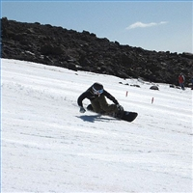
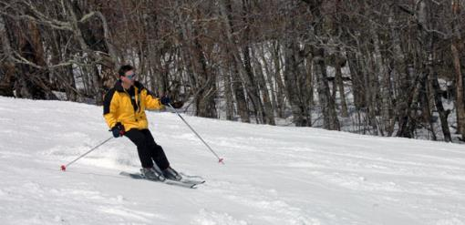
Would this help?
These men are carving.

Slide 46
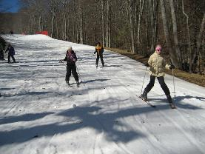
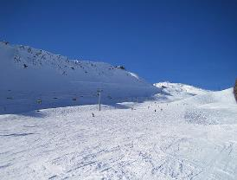
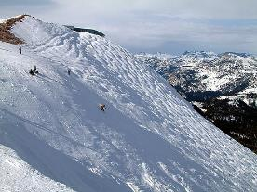
How about this?
Green Slope
Blue Slope
Black Slope

Slide 47
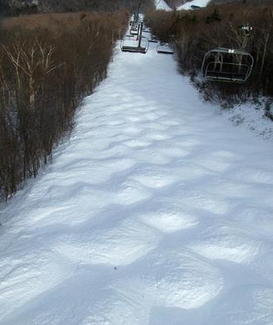
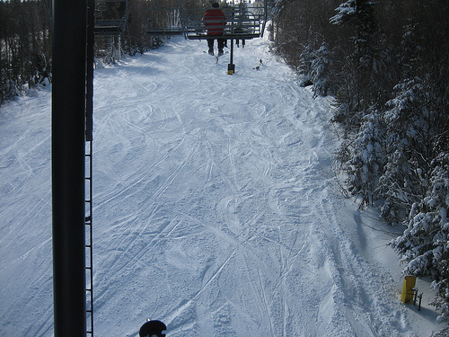
Moguls Packed Powder

Slide 48
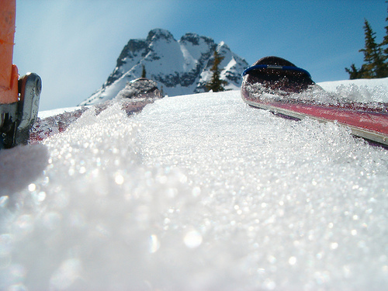
Corn Snow

Slide 49
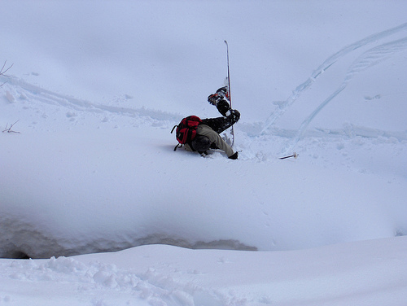
Face-plant

Slide 50
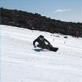








Carving is appropriate for most green and blue slopes
and even some black slopes. However, if you try to carve
through moguls, especially in packed powder or corn snow
you’re going to face-plant.
apropiado
especialmente

Slide 51
Vocabulary Gallery
Each table researches a different vocabulary strategy
Each team creates a poster explaining the activity
Walk freely through the Vocabulary Gallery!
Gallery Walk

Slide 52




1. Free Association
http://bit.do/freeassociation
2. Comparing Terms
http://bit.do/comparingterms
3. Classifying Terms
4. Solving Analogy Problems
5. Creating Metaphors
6. Vocabulary Charades
7. Talk a Mile a Minute
http://bit.do/morevocabulary
8. Pyramid Game
http://bit.do/ pyramidgame
Notes:
3.5 hours

Slide 53
Session Objectives
Content Objective
Language Objective
Today I explored sheltered instruction techniques and strategies to make content comprehensible for my ELLs.
Today I shared different ideas on how to implement sheltered instruction strategies in my classroom.

Slide 54

Exit Tickets
This new school year, I promise to…
http://bit.do/gatewaypromises

Slide 55
Thank you for your participation!
Karina E. Chapa, M.Ed.
Language Proficiency, Biliteracy and Cultural Diversity Director
kchapa@esc1.net
Facebook: Region One ESC Bilingual
Twitter @esc1bilingual @bilingualpride

